Slide 1
The Mechanical Behaviour of Bone
Prof. Sanjay Gupta
Professor
Department of Mechanical Engineering
Indian Institute of Technology Kharagpur
West Bengal, India
‹#›

Slide 2
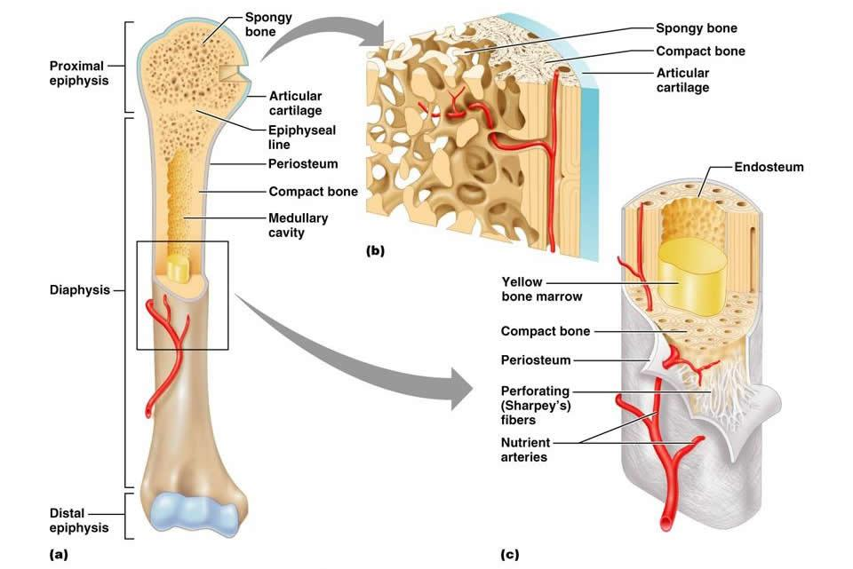
Bone Structure and Mechanical Properties
Bone is primarily composed of collagen fibres and small crystals of inorganic bone mineral, hydrated calcium hydroxyapatite, Ca₁₀(PO₄)₆(OH)₂
The hydroxyapatite (HA) contributes significantly to the stiffness of the cortical bone, while the collagen content determines the ductility.
From molecular perspective, bone mimics a true composite material. It consists of 65% mineral (HA), 35% organic matrix (mostly collagen fibres), water, cells and vessels.
‹#›

Slide 3
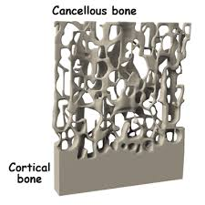
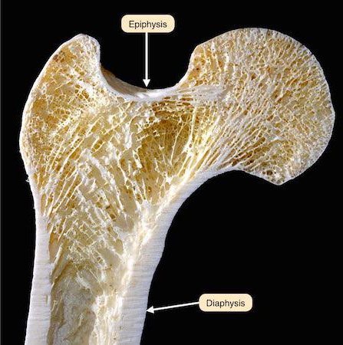
Classification of Bone
Classification of Bone tissue is based on bone porosity
Compact Bone as a dense solid bone with volume fraction of solid greater than 70%.
Cancellous or Trabecular Bone as a porous network of connecting rods or plates with volume fraction of solid less than 70%.
‹#›

Slide 4
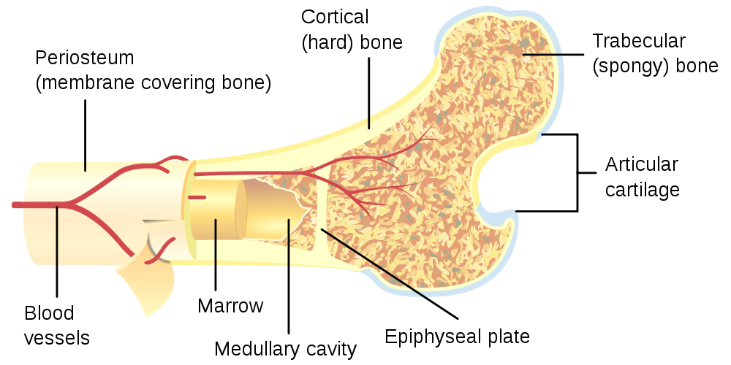
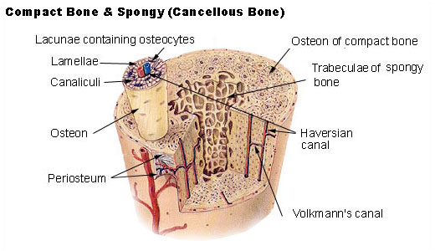
Cancellous and Cortical Bone
‹#›

Slide 5
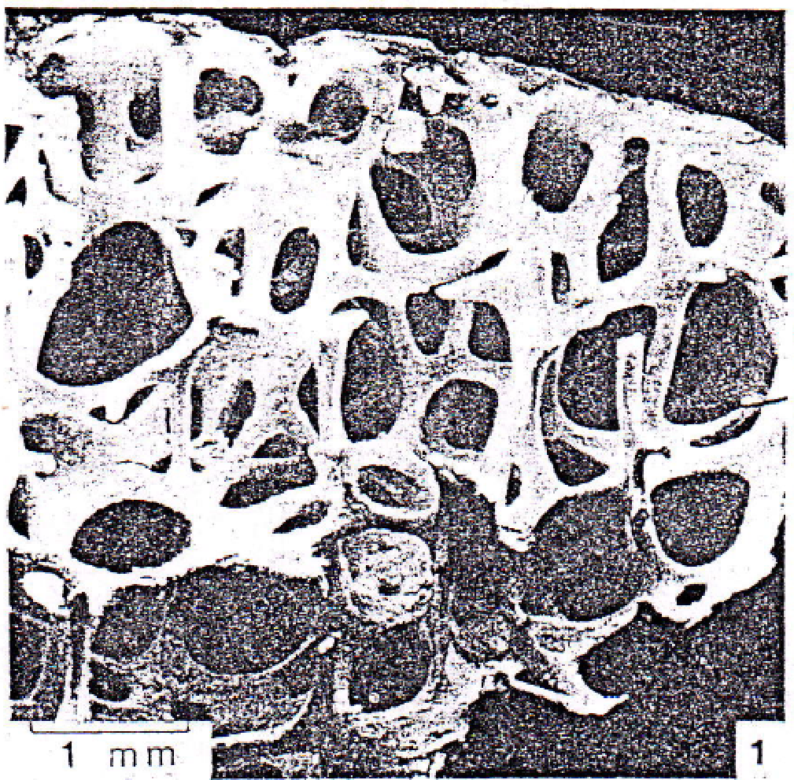
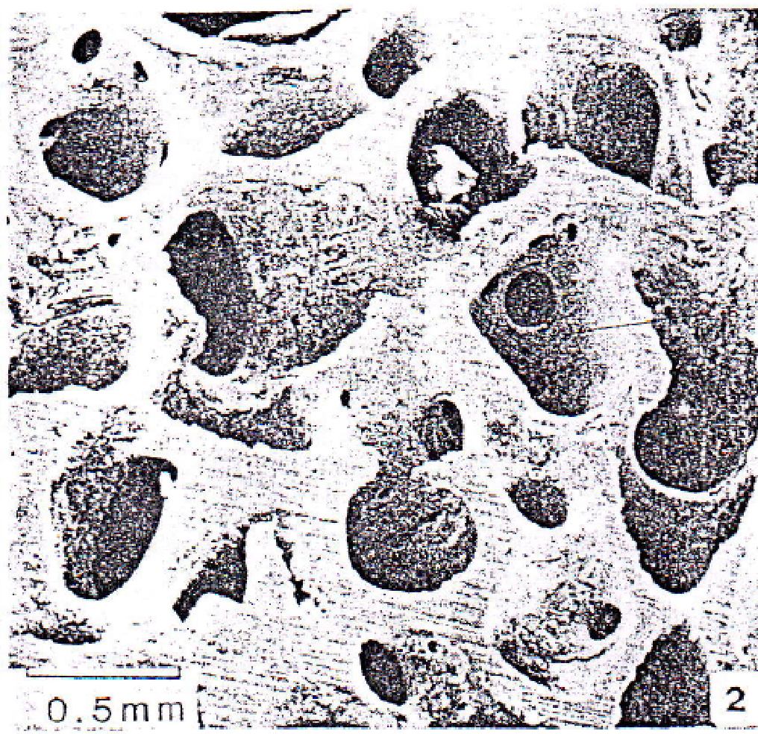
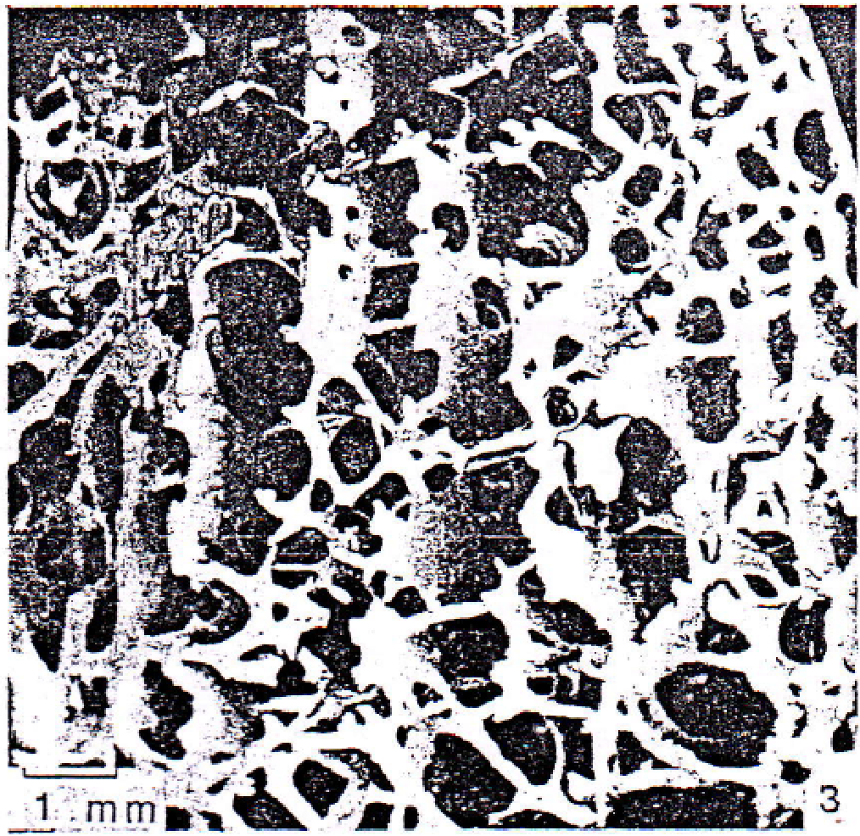
Bone Structure and Mechanical Behaviour
Compact bone tissue forms the structural shell of most bones and nearly all of the diaphyses of long bone.
Cancellous bone forms the inner core and is a cellular material made up of a connected network of rods and plates. A network of rods produces open cells while network of plates give closed cell.
The mechanical behaviour of cancellous bone is similar to cellular material, such as polymeric foam.
‹#›

Slide 6
Measurement of amount of Bone Mineralized Tissue
Bone as a Two-Phase Porous Material
Solid Phase: composed of mineralized bone tissue
Fluid Phase: composed of blood vessels, blood, marrow and interstitial fluid
Apparent (Structural) Density (ρ) is the mineralized tissue per total volume tissue.
Ash Density is the ash weight per total tissue volume.
Relative Density is the defined as the density of cellular solid (ρ∗) divided by the density of the solid it is made from (ρ_{s}). Relative density is equivalent to the volume fraction of a solid. At low relative densities, it has rods connecting to form open cells. At higher relative densities, more material is accumulated in the cell walls and the structure transforms into a more closed network of plates.
‹#›

Slide 7
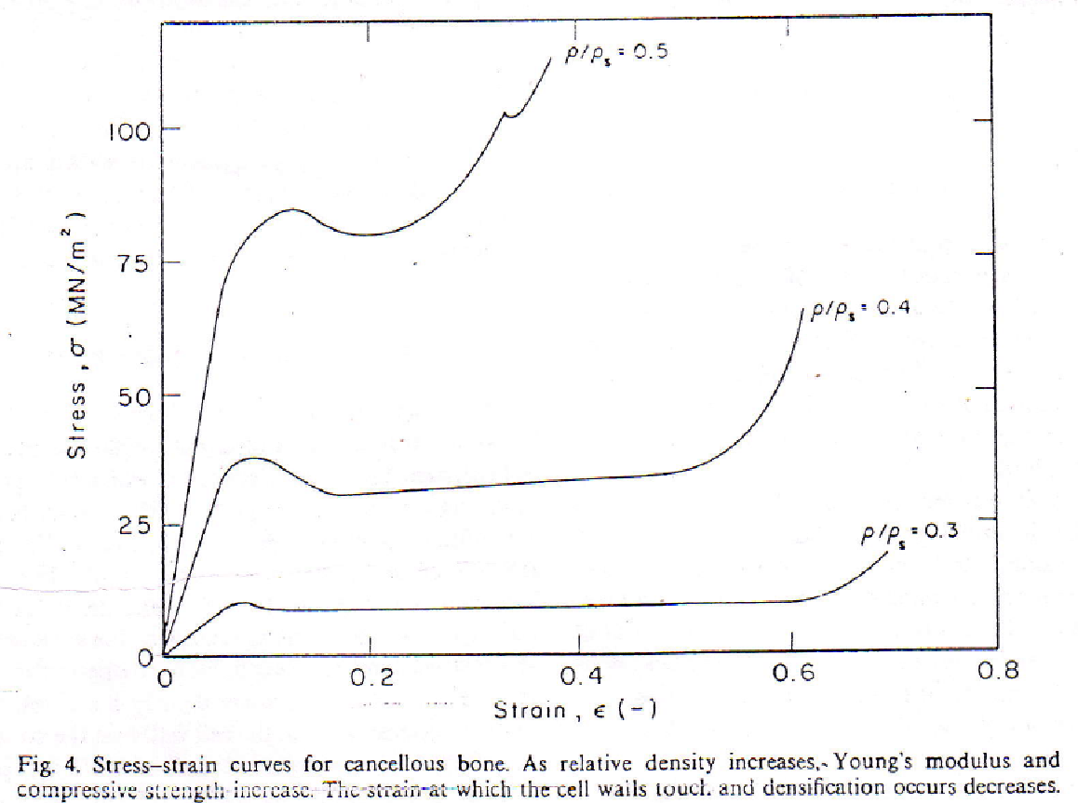
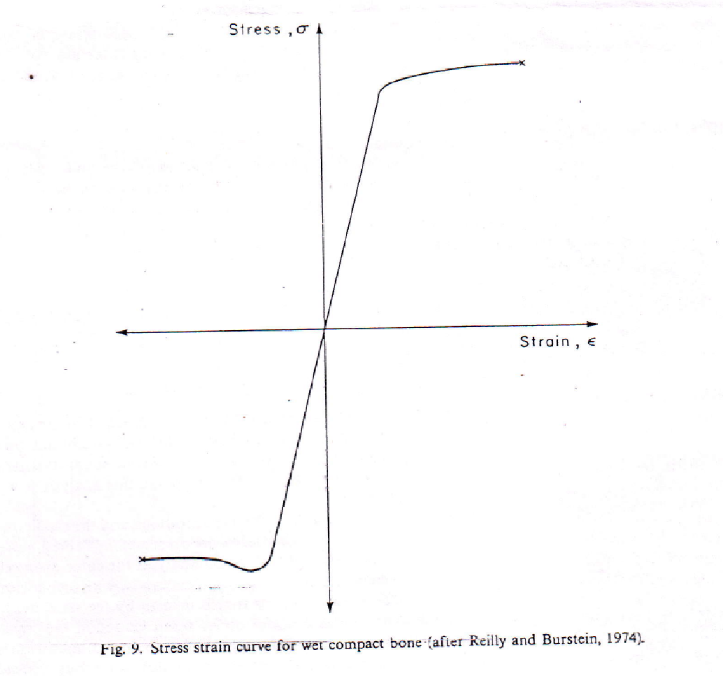
Stress-strain curve for Cancellous and Compact Bones
Cancellous Bone
Compact Bone
The stress-strain curve of cancellous bone has three distinct phases of behaviour.
Phase 1: Behaviour is linear elastic as the cell walls bend or compress axially.
Phase 2: Eventually, at high enough loads, the cells begin to collapse by elastic
buckling, plastic yielding or brittle fracture of the cell walls. This second phase of collapse progresses at a roughly constant load until the cell walls meet and touch.
Phase 3: Once this happens the resistance to load increases, giving rise to a final increasingly steep portion of the stress-strain curve.
‹#›

Slide 8
Relationship between Youngs’s modulus and Density
Power law models: E = a ρ ^{b}
where a and b can be determined
Carter and Hayes (1977) reported, E = 3790 έ^{0.06} ρ ³
where E is in MPa, ρ is in gm cm⁻³, έ is the strain rate
Specimens from human tibial plateau and bovine femoral condyles with different geometry tested for varying strain rates: 0.001 – 10 per second.
The viscous flow of marrow influenced the of trabecular bone only at a high strain rate (10.0 per second), which suggest that the presence of marrow during severe, traumatic, compressive loading in vivo may serve to absorb considerable energy.
However, apparent density a much more important factor than strain rate.
Reference: Carter, D.R., and Hayes, W.C. (1977). The compressive behaviour of bone as a two-phase porous structure. J. Bone Joint Surg. 59-A, 954-962.
‹#›

Slide 9
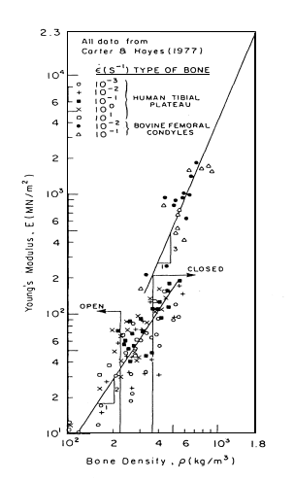
Young’s modulus – Apparent Density Relationship
It has been established, both theoretically (Gibson, 1985) and experimentally (Carter and Hayes, 1977, Dalstra et al., 1993), that the Young’s modulus of cancellous bone was strongly dependent on the bone’s apparent density.
Power law model was better suited than the linear model for mechanical properties of cancellous bone (Gibson, 1985, Currey, 1986; Turner et al., 1990).
Gibson’s analysis showed:
E ~ ρ ² for an open cell structure,
E ~ ρ ³ for a closed cell structure.
Results of Carter and Hayes (1977) agreed with this prediction and suggested a transition from rod-like to plate-like elements at a density of about 350 kg m⁻³, or a relative density of 0.20.
Gibson, L.J. (1985). The mechanical behaviour of cancellous bone. J. Biomech 18, 317-328.
Dalstra, M et al. (1993). Mechanical and textural properties of pelvic trabecular bone. J. Biomech 26, 523-535.
‹#›

Slide 10
Bone Adaptation
Bone is a highly adaptive material and is sensitive to disuse, immobilization, surgical intervention or vigorous activity at high loads. The bone tissue may change its properties in response to changes in mechanical environment.
It was determined at first by the German anatomist, Julius Wolff, that gave us the theory on the bone development named Wolff Law, that says:
"Each change in the form and function of a bone or only its function is followed by certain definitive changes in its internal architecture, and secondary changes equally definitive in its external compliance, in accordance to the mathematics law."
‹#›

Slide 11
Theory of Adaptive Bone Remodelling
Based on the following assumptions:
The process is regulated by mechanical stimuli detected by sensors within bone. Integrated with hormonal, genetic and metabolic factors, this causes bone apposition or resorption, by osteoblasts and osteoclasts.
Naturally loaded bone exists in a state of equilibrium. Normal loading and consequently a normal stimulus distribution, leads to an equilibrium state with normal bone morphology, in which the amount of bone formation is balanced by the amount of bone resorption.
An unnatural load alters the mechanical stimulus pattern and adaptive bone remodelling leads to a new equilibrium state. Bone tissue in the implanted bone strives to normalise its stress-strain pattern locally to the same value as in the natural bone, under the same loading conditions.
All changes in the mechanical stimulus, i.e. strain energy density levels between pre- and post-implantation were caused by the implant itself, and not by changes in external load.
‹#›

Slide 13
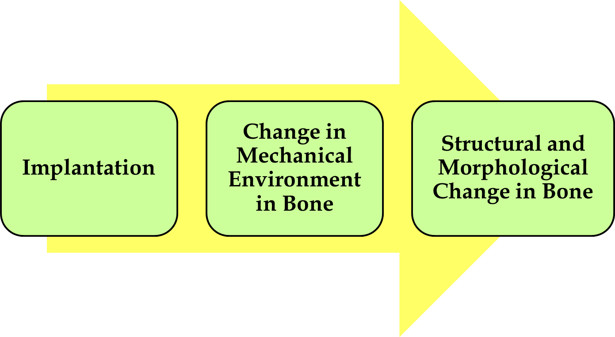
Effect of Implantation: Bone Remodelling

Slide 14
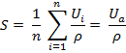
Time-dependant Adaptive Bone Remodelling Simulations
Bone adapts its structure in accordance with the altered mechanical environment, by bone resorption (activity of osteoclasts) and apposition (activity of osteoblasts) .
The phenomenon of adaptive bone remodelling explains the response of bone tissue to a significant alteration of its stress / strain environment.
Rate of bone loss or gain ~ S – S_{ref}
S : Remodelling signal, implanted femur
S_{ref} : Reference signal, intact femur
Strain Energy per unit bone mass averaged over loading history.
References: Theory of Bone Remodelling proposed by Huiskes et al. (1992), van Rietbergen et al. (1993) and Weinans et al. (1993)
‹#›

Slide 15
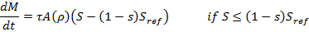
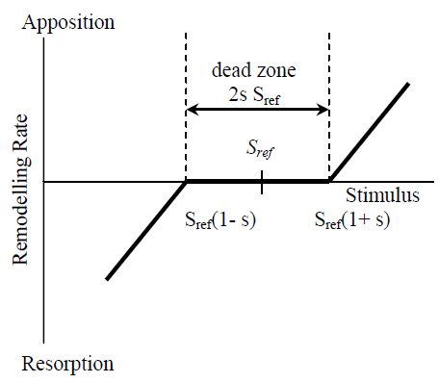
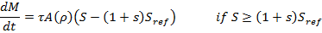
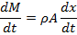
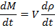
Adaptive Bone Remodelling Simulations
External Bone Remodelling
Change in Dimension
Internal Bone Remodelling
`
Change in Density
s = ±75% of reference stimulus

Slide 16
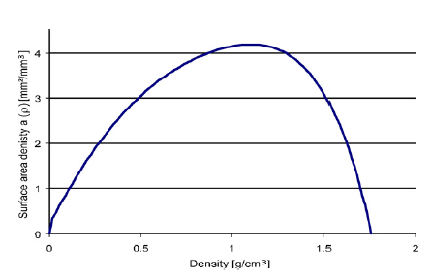
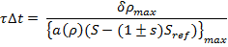
Adaptive Bone Remodelling Simulations
Internal Bone Remodelling
Martin’s Relation Between the Free Surface Area Density and Apparent Density of Bone
Site-specific, Patient-specific
Time step Calculation
(Scannel et al. 2009)

Slide 17
Adaptive Bone Remodelling Simulations
Check:
Equilibrium Condition

Slide 18
Computer Simulation of Adaptive Bone Remodelling
FEA implanted femur
Elastic Modulus
Remodelling Rule
Loading History
Lazy zone
Time-step Calculation
Actual Remodelling Signal
FEA intact femur
Reference Signal

Slide 19
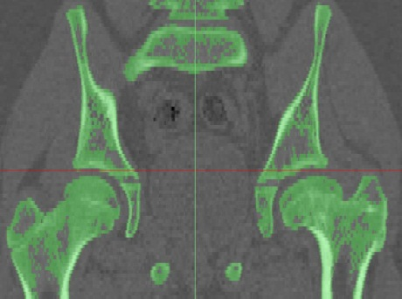
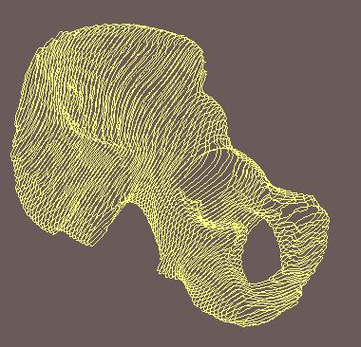
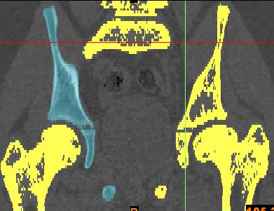
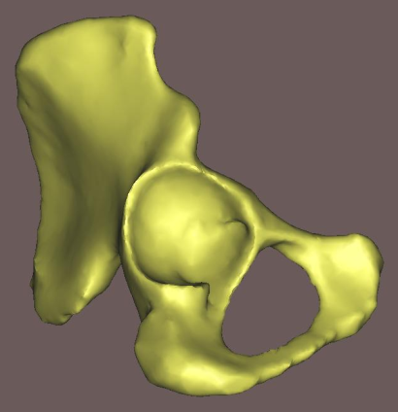
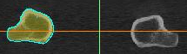
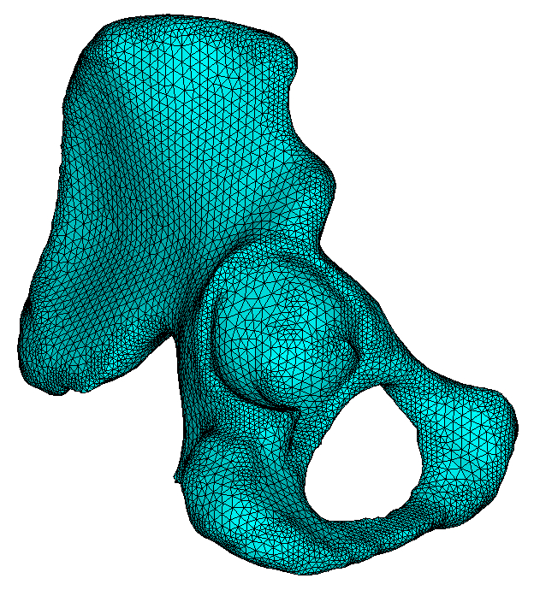
Geometry and Material Property
Image processing of CT– scan data slices
Apparent density vs. CT- grey value
(linear calibration): ρ = 0.022 + 0.001038 HU
Elastic modulus vs. apparent density
(power law): E = 2017.3 ρ^{2.46}
Cortical bone E = 17 GPa
A FE model of bone, where each bone element is assigned individual material properties, based on CT-grey value.
The FE model contained 221947 number of elements.
‹#›

Slide 20
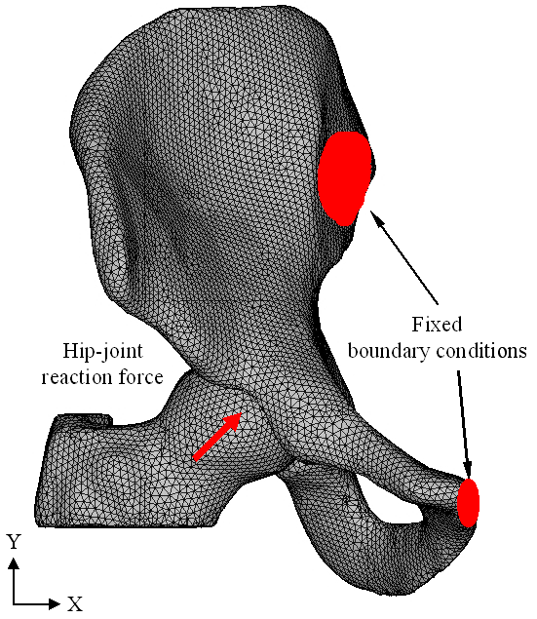
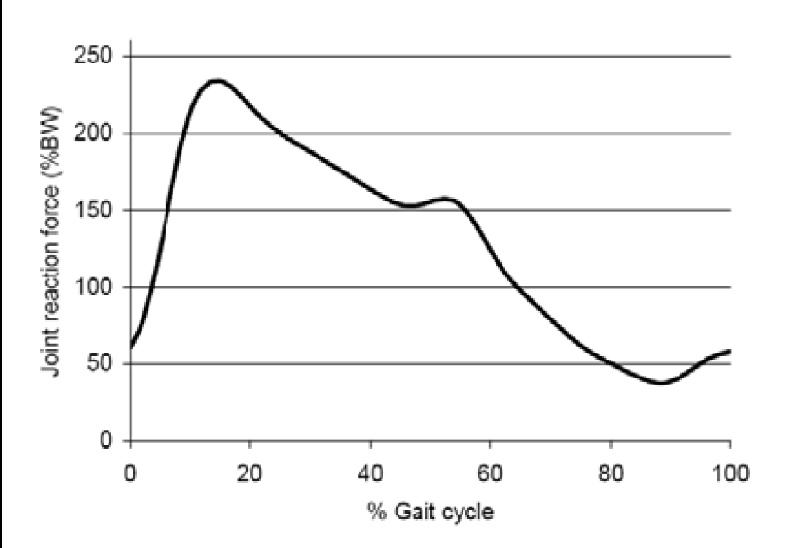
Applied Loading Conditions
Applied loading conditions include eight phases of a normal walking cycle
Hip-joint force
Muscle force: 21 muscle forces
Fixed constrains were applied at the pubis and the sacroiliac joint
References: Dostal and Andrews (1981).; Dalstra and Huiskes (1995).; Crowninshield and Brand (1981); Bergmann et al. (1990)
‹#›

Slide 21
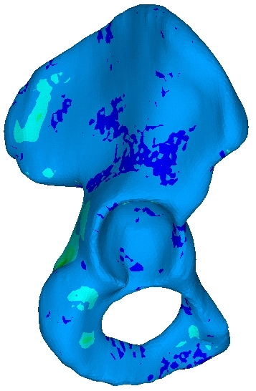
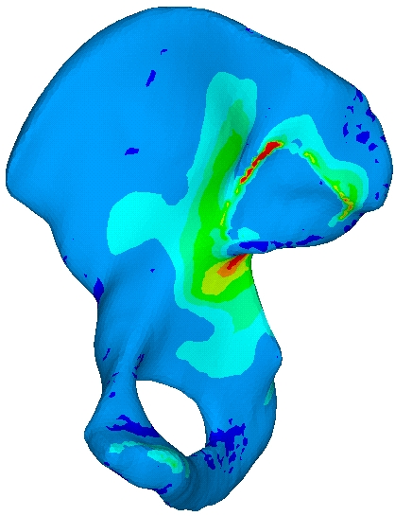
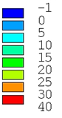
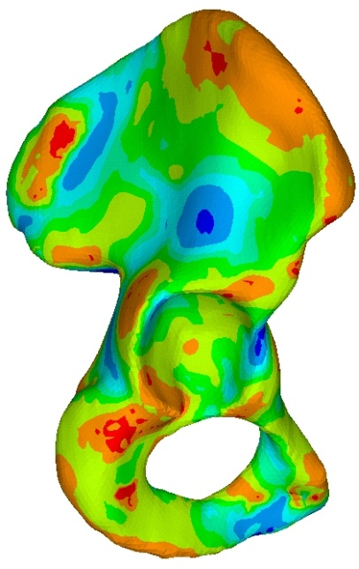
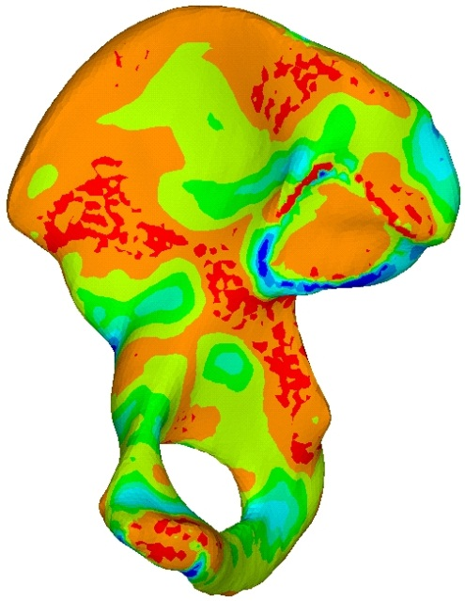
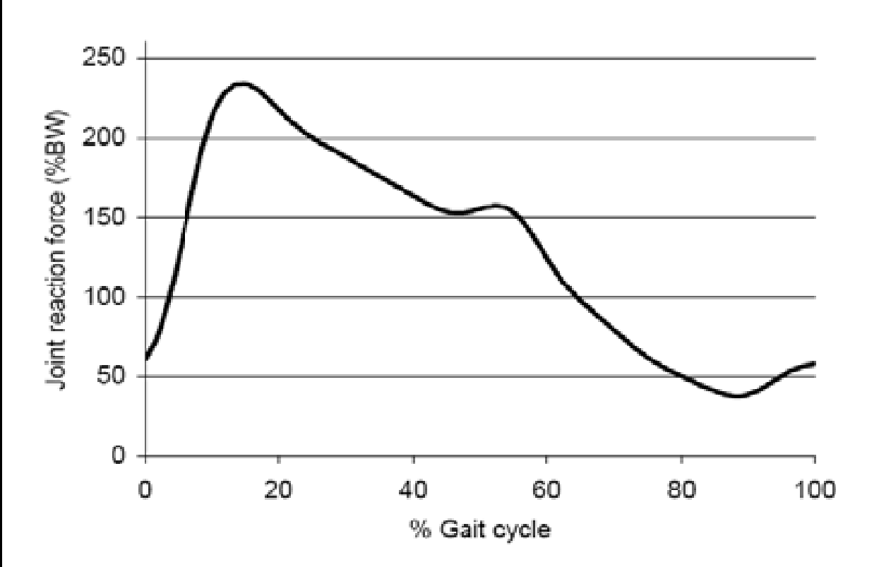
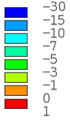
Principal Stress Distributions Across the Hemi-pelvis
Load case 2: Beginning right single support (max hip-joint reaction force).
Stress (MPa)
Third Principal
First Principal
Stress (MPa)
Ghosh et al. (2013), Comp Meth Biomech Biomed Engg, 18(7), 697-710.
‹#›

Slide 22
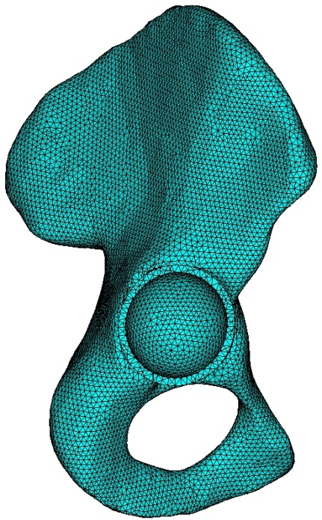
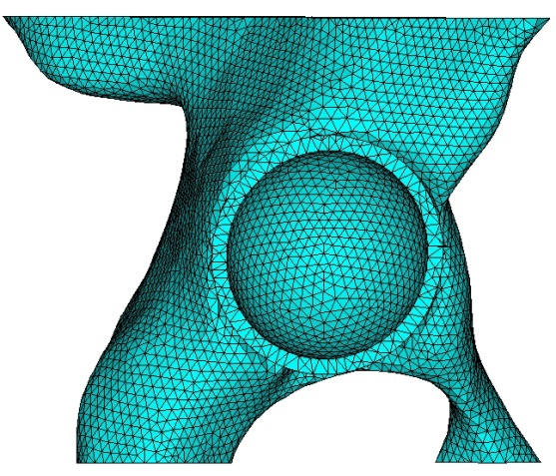
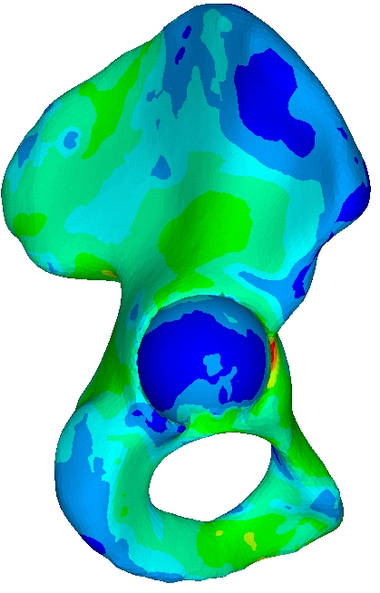
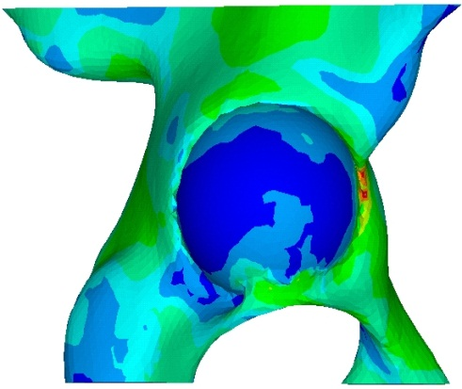
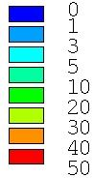
Stress (von Mises) Distributions after Implantation
(a)
Cut-boundaries (nodal displacements are transferred at these boundaries from full model).
Acetabular component
Full model
Submodelling Technique: Implanted Pelvis
Submodel
Stress (MPa)
‹#›

Slide 23
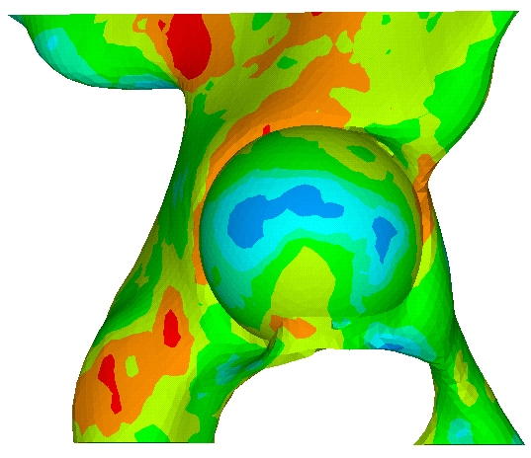
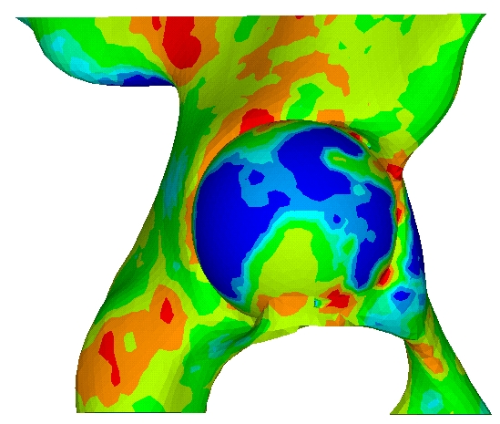
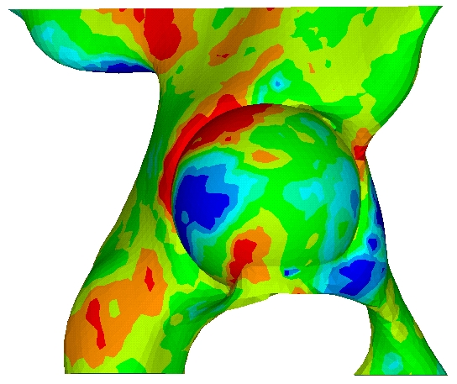
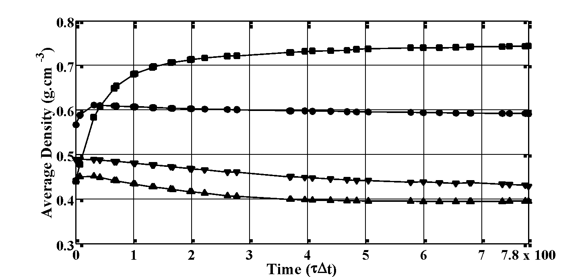
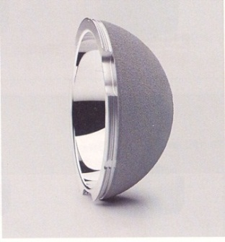
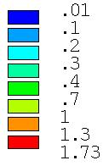
Changes in Bone density distribution: Metallic / Ceramic implant
1
2
1
2
1
2
3
4
3
4
3
4
Immediate post-operative
Bonded implant-bone interface
Debonded implant-bone interface
(ROI 1: ■; ROI 2: ●; ROI 3: ▼; ROI 4: ▲).
Density (g cm⁻³)
Ghosh et al. (2013) J Eng Med, Proc Inst Mech Engrs Part H, 227(5), 490-502.
‹#›

Slide 24
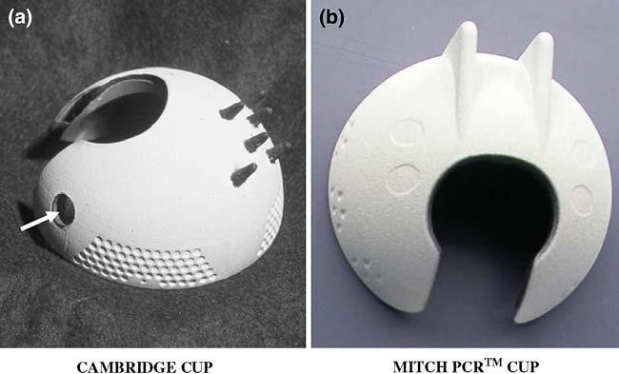
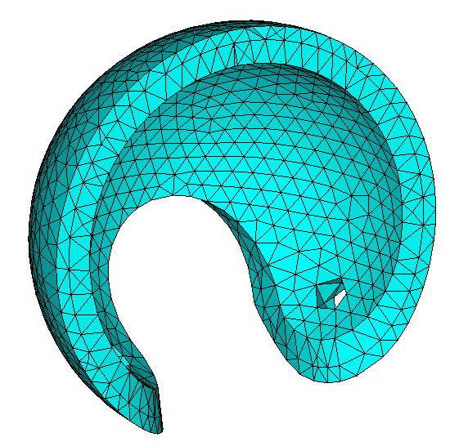
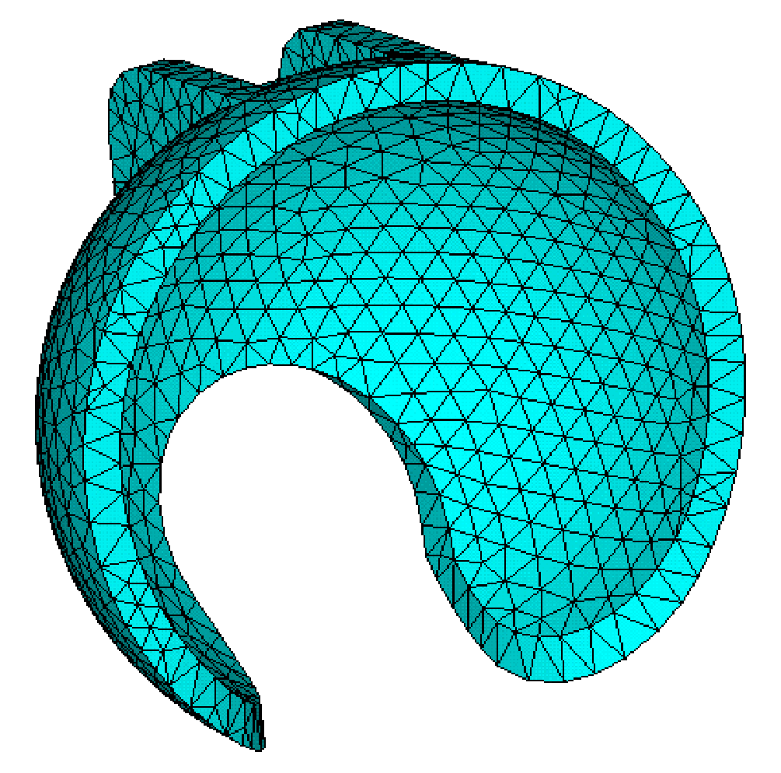
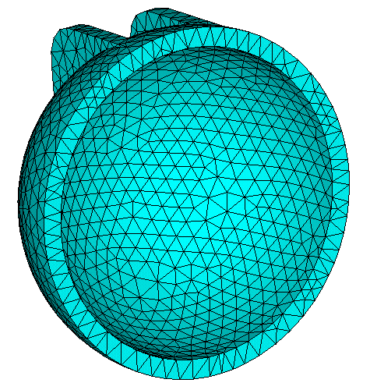
Composite Acetabular Components
Investigations on variation in: (1) Design, (2) Thickness
Prosthesis 1
Prosthesis 2
Prosthesis 3
3mm thick UHMWPE bearing, interlocked with 1.5 mm thick CFR-PBT (Cambridge Cup)
3mm thick CFR-PEEK (Mitch PCR Cup)
3mm thick CFR-PEEK (Hemispherical Cup)
E_{CFR-PBT} = 16.6 GPa, ν = 0.4; E_{UHMWPE} = 1.174 GPa, ν = 0.45
E_{CFR-PEEK} = 13 GPa, ν = 0.4
Ghosh and Gupta (2014), J Mechanical Behavior Biomedical Materials, 32, 257-269.
‹#›

Slide 25





Changes in bone density distributions around composite acetabular implants
1
2
1
2
3
4
3
4
Immediate post-operative
Prosthesis 1
Density (g cm⁻³)
1
2
1
2
3
4
3
4
Prosthesis 2
‹#›
Prosthesis 3

Slide 26











Effect of implant thickness: Bone Density Changes for CFR-PEEK implant
Section 1 – 1
Section 1 – 1
Section 1 – 1
Section 2 – 2
Section 2 – 2
Section 2 – 2
Density (g cm⁻³)
Section 3 – 3
Section 3 – 3
Section 3 – 3
Post-operative
Bone Remodelling with 3 mm thick implant
Bone Remodelling with 11 mm thick implant
‹#›

Slide 27
Major Findings
The effect of strain shielding was observed at the central part of the acetabulum, whereas a pronounced strain increase was observed around the periphery of the acetabulum.
Strain shielding was considerably higher for the bonded implant-bone interface condition as compared to the debonded implant-bone interface condition.
Horse shoe-shaped CFR-PEEK appears to be a better suited alternative bearing surface than other designs with regard to strain shielding, bone deformation and bone remodelling.
Thickness of the acetabular component also played a crucial role in implant-induced bone adaptation.
‹#›

Slide 28





Adaptive Bone Density Changes: a Comparative Study
-55%
-18%
-67%
-28%
-42%
-36%
-4%
-10%
g.cm⁻³
Post-operative
Long-term
Post-operative
Long-term
‹#›

Slide 29
Acknowledgements
Indian Institute of Technology Kharagpur
Department of Biotechnology, New Delhi
University of Southampton, U.K.
UKIERI, British Council
‹#›

Slide 30
~ Thank you for listening ~
‹#›

